Slide 1


Review of the Week
Blockchain Basics, Consensus Protocols, Wallets, Transactions, Exchanges, Mining
Sevgin Mustafov
Blockchain Developer & Course Developer
Academy School of Blockchain
http://kingsland.academy

Slide 2

Table of Contents
What is Blockchain?
Private and Public Blockchains
What are Encryption and Hashing?
Consensus Protocols
What are Cryptocurrency Wallet and Transaction?
Cryptocurrency Exchanges
What are Cryptocurrency Mining and Network Difficulty?
Solo vs. Pool Mining

Slide 3





Basics of Blockchain
Blockchain Technology Explained

Slide 4
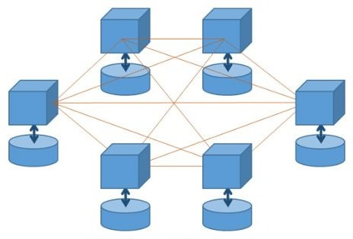

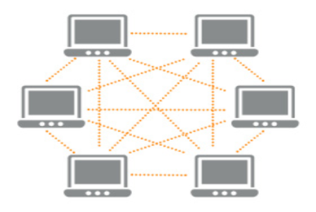

What is Blockchain?
Distributed ledger
Decentralized
(no owner)
Peer-to-Peer network
Secure
Nodes hold ledger of facts + history of updates
Immutable
Transactions are verified by the entire network

Slide 5


What is Cryptocurrency?
Example: Bitcoin The first decentralized crypto-currency
Crypto-money:
Not guaranteed, virtual, highly risky, volatile
Other examples: Ethereum, IOTA, Dash

Slide 6

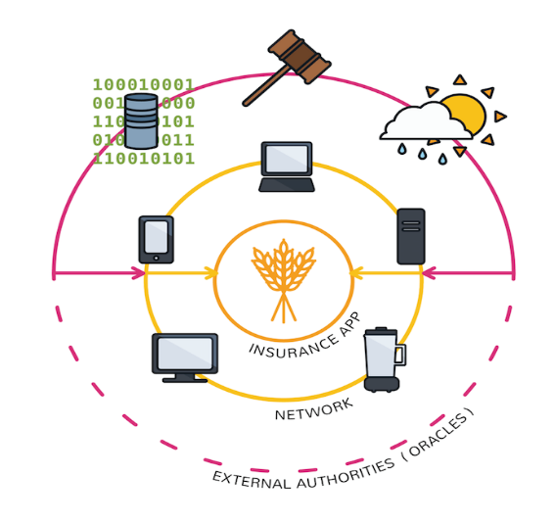

Application of the Blockchain Technology
Decentralized applications
Cryptocurrencies
Digital investments
Digital money with no central bank
Fund raising / ICO / token sales
Removing the middlemen

Slide 7


Private and Public Blockchains
Private Blockchain
Operated by an organization
Restricted access, requires an invitation
Transactions are internal
Faster transactions
Public Blockchain
Completely open and public
Anyone can join and participate
Transactions are public
No one controls the shared ledger data

Slide 8
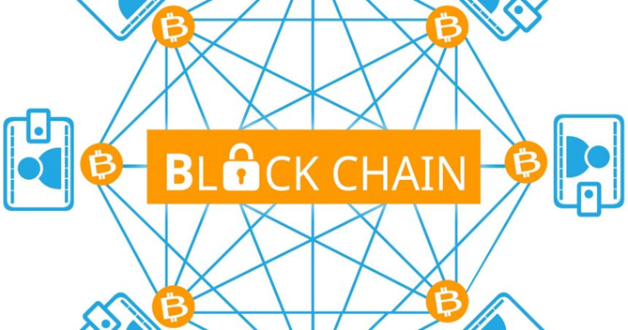
Double-Spending Problem
Double spending problem == spend certain amount twice
Blockchain prevents double spending
The blockchain holds signed chain of blocks holding transactions
All pending transactions are collected in the network nodes
A single node creates the next block
The next block creator puts the pending transactions (after validation) in the next block (and prevents double spending)

Slide 9

Blockchain Cryptography
Cryptography, Hashing, Digital Signatures

Slide 10

What is Cryptography?
Cryptography is providing security for information
Storing and transmitting data in a secure way
Encrypting and decrypting data (symmetric / asymmetric)
Hashing data (message digest)
Digital signatures
Key-exchange algorithms
Key derivation algorithms

Slide 11
What are Encryption and Hashing?
Symmetric Encryption (e.g. AES)
Only one secret key to cipher and decipher information
The sender and the recipient should know the secret key
Asymmetric Encryption (e.g. RSA)
Uses public and private keys to encrypt and decrypt data
Person can encrypt a message using the public key of the receiver
Message can be decrypted only with the recipient's private key
Hashing (e.g. SHA-256)
One-way function – infeasible to invert

Slide 12

Consensus and Consensus Algorithms
Proof-of-Work / Proof-of-Stake / Others

Slide 13
Consensus Protocols
Proof of Work
A proof of work is a piece of data which is difficult to produce and easy for others to verify
Producing a proof of work can be a random guessing process
Needs computing power
Proof of Stake
Designed to increase network security
Next block’s creator is chosen via various combinations of random selection and wealth

Slide 14
Hard and Soft Forks
Hard Fork
Radical change to the blockchain network protocols
Makes previously invalid blocks / transactions valid (or vice-versa)
Nodes running previous versions are no longer be accepted
Soft Fork
Backward-compatible change in the blockchain software protocol
No change in transactions and blocks

Slide 15

Cryptocurrency Wallets and Crypto Exchanges
Types of Wallets and Exchanges

Slide 16
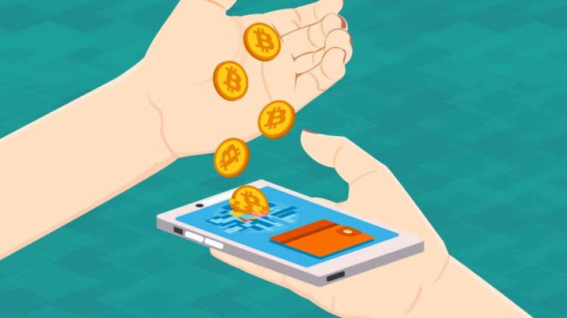
What is Cryptocurrency Wallet?
Software program (e.g. mobile / desktop / Web app)
Stores private and public keys and blockchain addresses
Interacts with various blockchains (through APIs)
Enables users to send and receive digital currency
Sings and posts transactions
Monitor the account balances
Hold transaction history
Most often based on mnemonic phrase

Slide 17
Types of Wallets?
Paper (private key + blockchain address printed on a paper)
Brain (passphrase used to derive the HD wallet seed key)
Online (Web app holding the private keys + addresses)
Software wallets
Desktop (holds keys + addresses in a desktop app)
Mobile (holds keys + addresses in a mobile app)
Hardware (holds keys securely in a USB device)

Slide 18
Cold and Hot Wallets
Cold Wallets
Similar to savings accounts
Not connected to the internet
E.g. hardware wallets (like Trezor or Ledger Nano )
Hot Wallets
Like checking accounts
Connected to the internet
Online and software wallets (like Bittrex, Exodus, Jaxx, etc.)

Slide 19

Cryptocurrency Exchanges
Trade cryptocurrencies for other assets
“Traditional” cryptocurrency exchanges
Trade based on the current market price
Cryptocurrency brokers
Buy and sell cryptocurrencies at a price set by the broker
Direct trading exchanges
Peer-to-peer trading
Cryptocurrency funds
Pools of professionally managed cryptocurrency assets

Slide 20
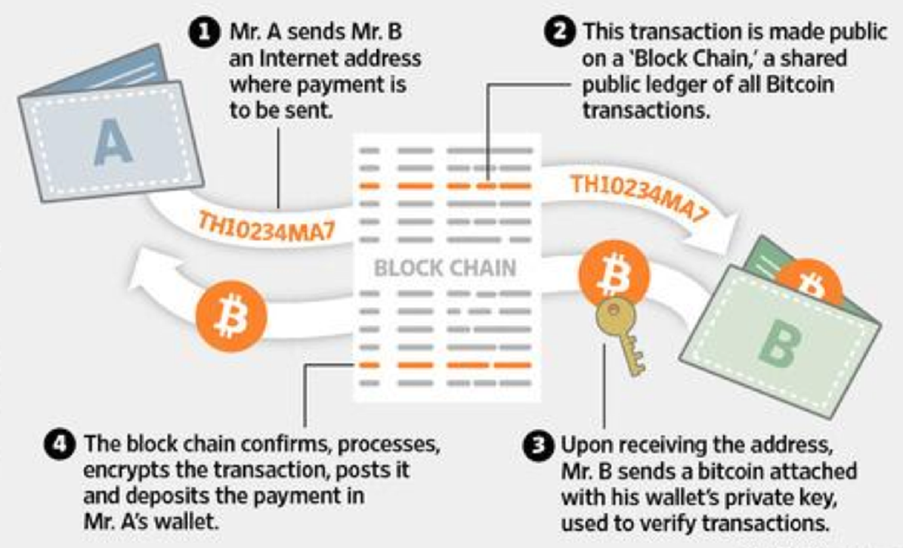
Keys, Addresses, Transactions, Blocks

Slide 21
Public / Private Keys & Blockchain
private key
public key
address
transaction
sign by private key
signature
signed transaction
verify by address key
valid / invalid

Slide 22

Blockchain == Chain of Data Blocks
Block #0 (genesis block)
Block #1
Block #3
timestamp
block_hash
timestamp
block_hash
timestamp
block_hash
prev_hash
nonce
prev_hash
nonce
prev_hash
nonce
all_transactions_hash
all_transactions_hash
all_transactions_hash
transaction #1
hash
transaction #1
hash
transaction #1
hash
transaction #2
hash
transaction #2
hash
transaction #2
hash
transaction #3
hash
transaction #3
hash
transaction #3
hash
…
…
…

Slide 23
Transactions and Blocks
Consensus algorithm
Consensus algorithm
Blockchain clients create and sign transactions
Blockchain Network
Selects the winning node (a lucky miner)
Blockchain Node #1
Blockchain Node #7
pending transactions
Transaction A
pending transactions
Transaction B
Blockchain Node #2
Validates the pending transactions and creates the next block
Transaction C
pending transactions
Transaction …
Next (New) Block
Propagate for validation
Transactions are sent to the network
confirmed transactions
Blockchain Node #...

Slide 24
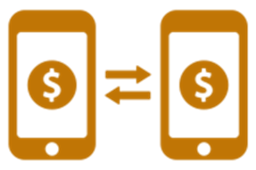
What is Transaction?
Transfer of cryptocurrency value
Signed by the source account's private key
Validated by the mining / validating nodes
Visible in the blockchain history
Each transaction holds
Source + destination address(s) + value + sender's digital signature
Blocks hold batches of valid transactions
Unconfirmed until included into a block
After confirmed → irreversible

Slide 25

Cryptocurrency Mining
Mining Process and Pools

Slide 26
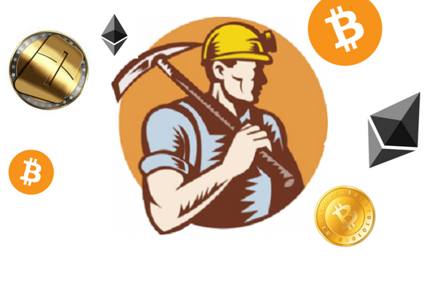
What is Cryptocurrency Mining?
Miners in the blockchain keep the network up and running
24/7 computer accounting a.k.a. “verifying transactions”
Miners get paid a small reward for their accounting services
Pay their operational costs, including electricity and hardware
Profit from rewards (next block + fees)
Proof-of-work mining use brute-force to find a hash starting with many zeroes
Runs on ASIC, GPU and CPU

Slide 27
What is Network Difficulty?
Measures how difficult it is to find a hash below a given target
Bitcoin difficulty adjustment
Every 14 days
Keep the block time at ~ 10 minutes
Bitcoin network difficulty changes
Every 2016 blocks
Minimum difficulty is 1
Maximum difficulty about 2^224

Slide 28
Solo vs. Pool Mining
Solo mining
Low probability to "find" a block
Do not share the block reward
Pool mining
Miners share their processing power over a network
The pool combines the collective mining effort
The pool split the reward equally
Pools collect service fees

Slide 29
Advantages and Disadvantages of Mining Pools
Advantages
More stable income, proportional to the effort
Potential of generating a higher income
Potentially lower costs of mining
Disadvantages
Mining pools may suffer interruptions
Block rewards have to be shared
Potentially unfavorable pool reward structure

Slide 30
CPU, GPU and ASIC Mining
CPU
Financially unwise (for most hashing algorithms), works for Monero
Amount of Bitcoins produced < cost of power to operate
GPU
Faster and more efficient than CPU, works for Ethereum
Mining rigs
ASIC
Application-specific integrated circuit
Designed for Bitcoin mining (2013)
Vastly faster than all others

Slide 31

Summary
Blockchain is decentralized distributed ledger
Cryptocurrency is a digital currency that uses cryptography for security and the blockchain for decentralization
Encryption can be symmetric and asymmetric
Hashing is one-way message digest function
Wallet is software, managing private and public keys
Transaction is transfer of cryptocurrency value
Block is a set of transactions in the blockchain network
Mining is the process of adding transaction records public ledger

Slide 32
Review of the Week
http://www.kingsland.academy

